Slide 1
Analysis of Trends, Anomalies, and Missing Data in Water Quality
Subtitle: Understanding Environmental Factors Impacting Bird Populations
KEERTHANA JOTHI

Slide 2
INTRODUCTION:
Context:
The Rose-Crested Blue Pipit population decline in Boonsong Lekagul Wildlife Preserve is linked to environmental factors, particularly water quality.
Objective:
Analyze trends, anomalies, and missing data in water quality metrics to identify potential causes and suggest conservation strategies.
Keerthana Jothi

Slide 3
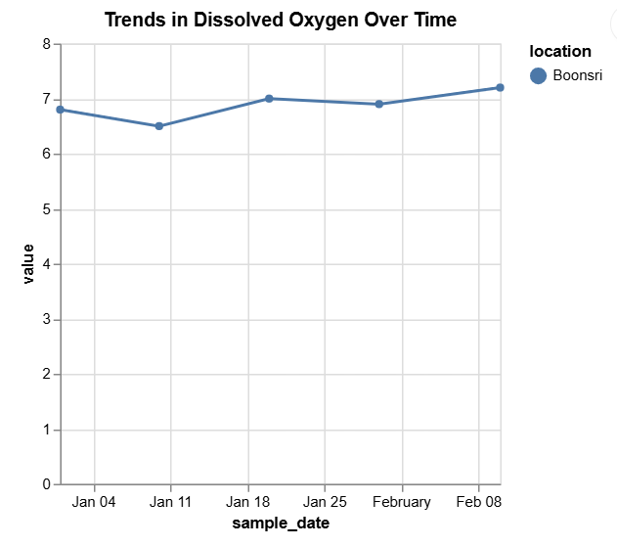
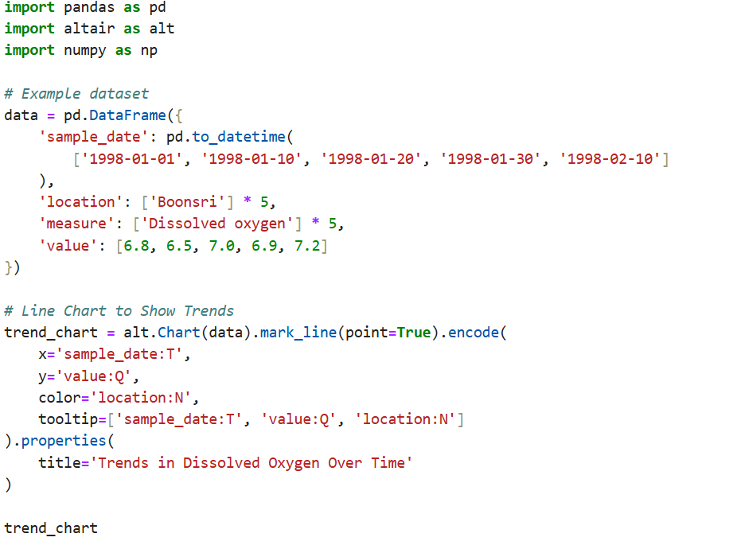
TRENDS IN DISSOLVED OXYGEN OVER TIME:
Keerthana Jothi

Slide 4
Findings:
Variations in dissolved oxygen levels at "Boonsri" location reveal temporal patterns.
Stable or increasing levels suggest recovery, while declines indicate deteriorating water conditions.
Graph Explanation:
Line chart showcases dissolved oxygen trends over time.
Tooltips enable precise date-wise analysis of values.
This helps identify periods of ecological stability or potential stress. Trends in Dissolved Oxygen Over Time
Keerthana Jothi

Slide 5
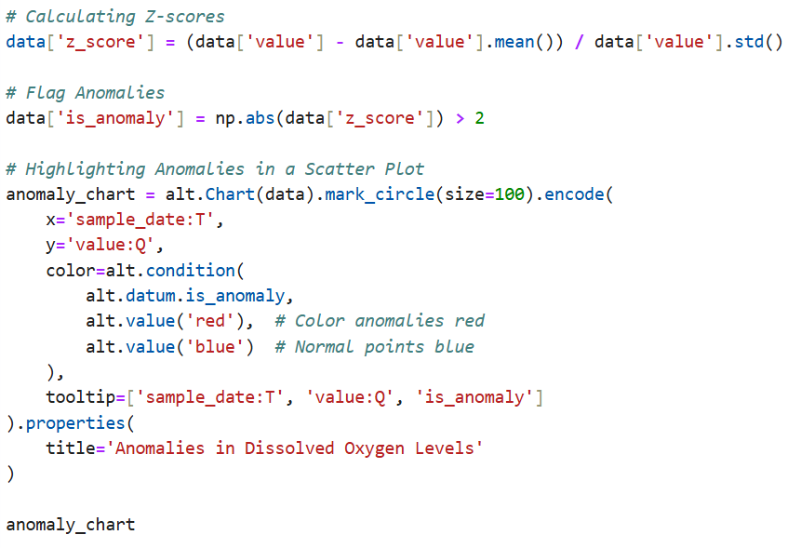
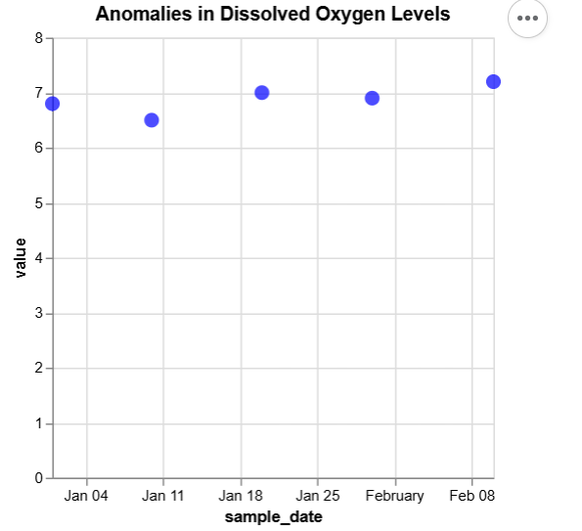
ANOMALY DETECTION:
Keerthana Jothi

Slide 6
Findings:
Outliers detected in dissolved oxygen values indicate sudden pollution events or environmental changes.
These anomalies may signify critical incidents affecting bird populations.
Graph Explanation:
Scatter plot highlights anomalies using Z-score analysis.
Each point represents dissolved oxygen measurements over time.
Anomalies (e.g., Z-score > 2) allow prioritization of locations for further investigation.
Keerthana Jothi

Slide 7
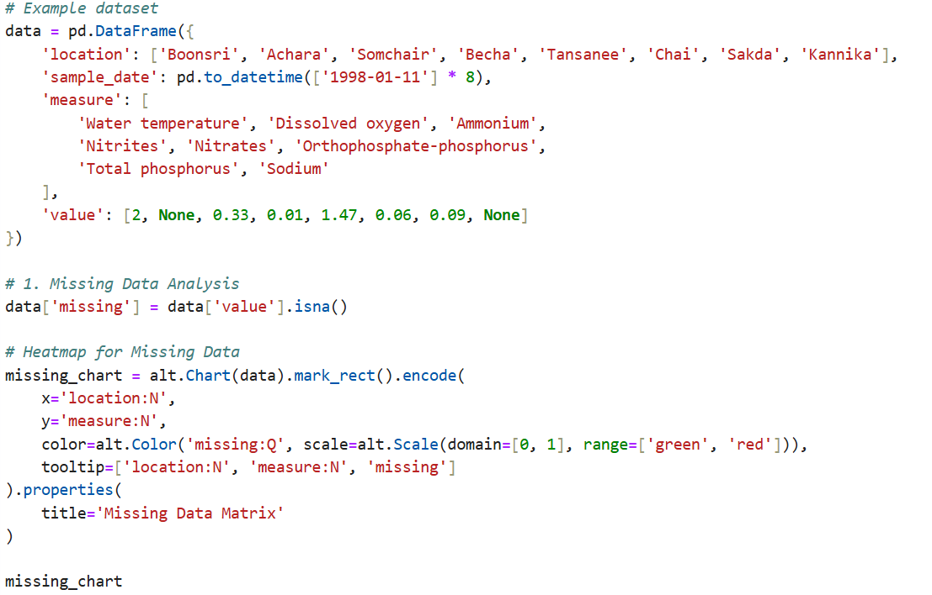
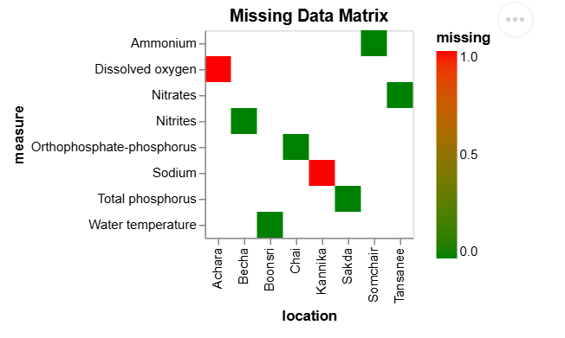
MISSING DATA ANALYSIS:
Keerthana Jothi

Slide 8
Keerthana Jothi
Findings:
Missing data observed in specific parameters like dissolved oxygen and sodium for certain locations.
Systemic gaps indicate data collection or sensor issues.
Graph Explanation:
Heatmap visualizes missing data across locations and measures.
Red cells highlight missing values, green cells represent complete data.
Temporal gap detection line chart identifies missing data over time.

Slide 9
CONCLUSION:
Keerthana Jothi
Summary of Insights:
Trends: Temporal patterns in dissolved oxygen levels indicate changing water conditions.
Anomalies: Outliers highlight areas of immediate concern for environmental monitoring.
Missing Data: Identifies systemic issues in data collection, impacting reliability.

Slide 10
THANK YOU!

